Slide 1
Sorting and Sequence
A Set of Combinatorial Problems
CommonAnts (Liu Cheng-ao)
2022.7

Slide 2
Index. Total
Basic Model: Sequence
Sorting in View of OI
  Introduction of View in OI
  In View of Basic Operations
  In View of Algorithm Structure
  Sorting Algorithms
Permutation Equivalence
Appendix. Bound of Comparison Sorting
Structure Based on Orders (With Individual Index)

Slide 3
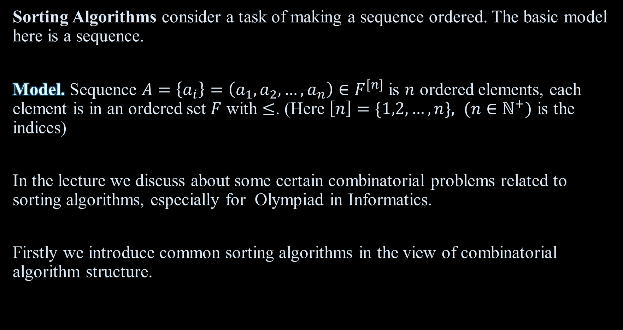
Model
Sorting Algorithms consider a task of making a sequence ordered. The basic model here is a sequence.
Model. Sequence $A=\left\{a_{i}\right\}=\left(a_{1},a_{2},…,a_{n}\right)∈F^{[n]}$ is $n$ ordered elements, each element is in an ordered set $F$ with $≤$. (Here $\left[n\right]=\{1,2,…,n\}, (n∈ℕ^{+})$ is the indices)
In the lecture we discuss about some certain combinatorial problems related to sorting algorithms, especially for Olympiad in Informatics.
Firstly we introduce common sorting algorithms in the view of combinatorial algorithm structure.

Slide 4
Views (OI specialized)
(In studying mathematics) A view is a way of symbolically thinking and representing a theory, or a way to answer the question like “what is the essence of XXX for me?”. It is a near-synonym of schema or paradigm.
In OI, the most common views are Combinatorial Algorithm-Data Structure for algorithm design and Sequence-Tree-Graph-Plane-Multidimensional Geometric Intuition for models. These contains almost all OI problems “supposed to be solved in contest without certain algorithm/algebraic or other theory individually introduced and hard to extend”.
Of course, like schemas or paradigms, views have heavy limitations and usually obstruct useful thinking.
However, it profits much to have views for beginners especially when trying to understand books/articles for the first time.

Slide 5
View of Combinatorial Algorithm Structure (OI specialized)
The Combinatorial Algorithm-Data Structure is a view of algorithm design. In this view, algorithm is to answer a question, and it does like this: dividing (like quotient set) the model into smaller parts (may by its combinatorial property), solve the parts by elemental operations, and combine them by a certain algorithm related to the division structure. The “elemental operations” may be naive, recursive sub-model, or a “packaged” different question. Often the “packaged different question” contains normal structure, modification and queries, and thus be a data structure.
The view of models contains certain theories like order, sequence, index-range-time model, intervals, subtrees, special types of graphs, naive division and recursion, multidimensional embedding, and they have an important common language of 2D (discrete) geometric intuition. This paragraph is not practical and is only for a preview.

Slide 6
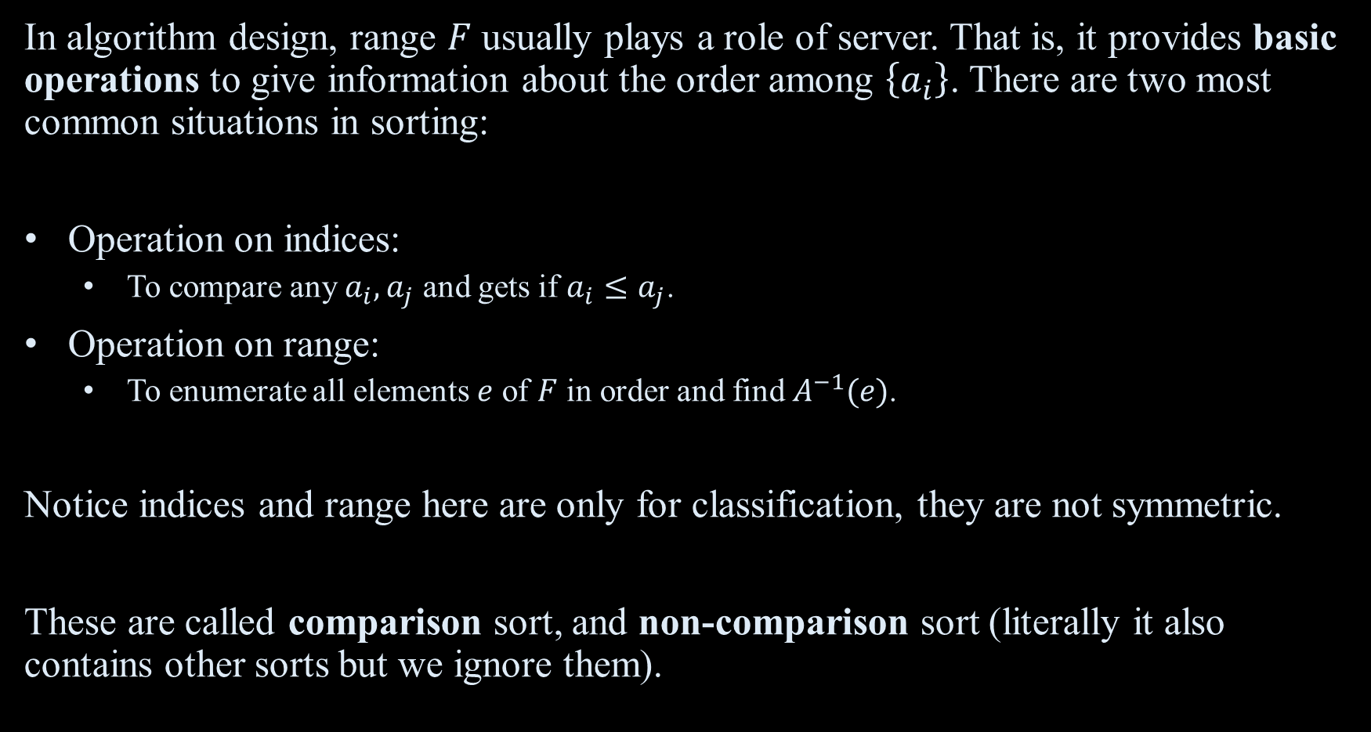
Sorting: In View of Basic Operations
In algorithm design, range $F$ usually plays a role of server. That is, it provides basic operations to give information about the order among $\left\{a_{i}\right\}$. There are two most common situations in sorting:
Operation on indices:
  To compare any $a_{i},a_{j}$ and gets if $a_{i}≤a_{j}$.
Operation on range:
  To enumerate all elements $e$ of $F$ in order and find $A^{−1}(e)$.
Notice indices and range here are only for classification, they are not symmetric.
These are called comparison sort, and non-comparison sort (literally it also contains other sorts but we ignore them).

Slide 7
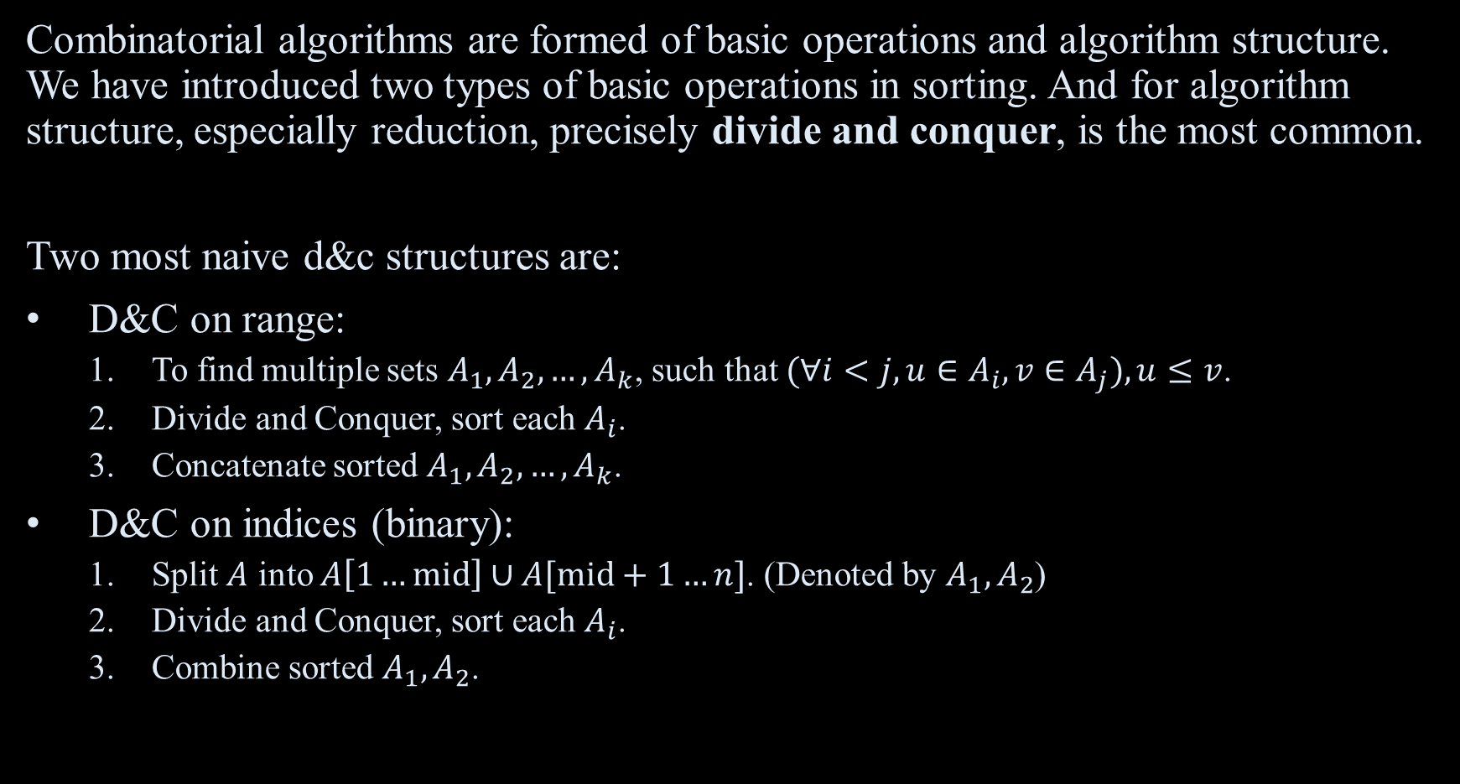
Sorting: In View of Algorithm Structure
Combinatorial algorithms are formed of basic operations and algorithm structure. We have introduced two types of basic operations in sorting. And for algorithm structure, especially reduction, precisely divide and conquer, is the most common.
Two most naive d&c structures are:
D&C on range:
  To find multiple sets $A_{1},A_{2},…,A_{k}$, such that $(∀i<j,u∈A_{i},v∈A_{j}),u≤v$.
  Divide and Conquer, sort each $A_{i}$.
  Concatenate sorted $A_{1},A_{2},…,A_{k}$.
D&C on indices (binary):
  Split $A$ into $A\left[1…mid\right]∪A[mid+1…n]$. (Denoted by $A_{1},A_{2}$)
  Divide and Conquer, sort each $A_{i}$.
  Combine sorted $A_{1},A_{2}$.

Slide 8
Basic sorting algorithms
By basic operation and algorithm structure we have up to 6 types of basic sorting algorithms:
The table contains most common algorithms. (We can find that D&C is really popular in algorithm!)
In the view of combinatorial algorithm structure, we can say that radix sort and bucket sort processes the D&C recursion in different ways.
Selection Sort and Bubble sort are equivalent in the view of parallel, we’ll discuss about it later.
Heap sort is not here, because in the view of combinatorial algorithm structure it makes a new server(data structure) to serve the operations “finding a minimum”, “insertion” and “deletion”.
 | Naive | D&C on range | D&C on indices
Operation on range (Non-Comparison) | Counting Sort | Radix Sort (Bottom-Up) Bucket Sort (Top-Down) | -
Operation on indices (Comparison) | Selection Sort Bubble Sort | Quick Sort | Merge Sort

Slide 9
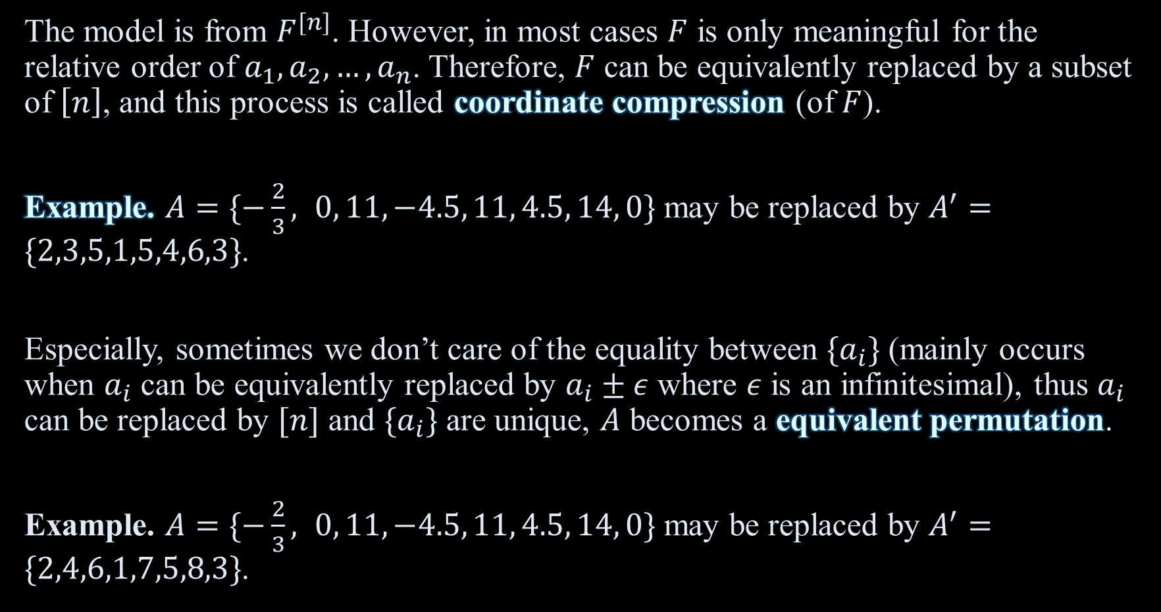
Model
The model is from $F^{[n]}$. However, in most cases $F$ is only meaningful for the relative order of $a_{1},a_{2},…,a_{n}$. Therefore, $F$ can be equivalently replaced by a subset of $\left[n\right]$, and this process is called coordinate compression (of $F$).
Example. $A=\{−\frac{2}{3}, 0, 11, −4.5, 11, 4.5, 14, 0\}$ may be replaced by $A^{′}=\{2,3,5,1,5,4,6,3\}$.
Especially, sometimes we don’t care of the equality between $\{a_{i}\}$ (mainly occurs when $a_{i}$ can be equivalently replaced by $a_{i}±ε$ where $ε$ is an infinitesimal), thus $a_{i}$ can be replaced by $[n]$ and $\{a_{i}\}$ are unique, $A$ becomes a equivalent permutation.
Example. $A=\{−\frac{2}{3}, 0, 11, −4.5, 11, 4.5, 14, 0\}$ may be replaced by $A^{′}=\{2,4,6,1,7,5,8,3\}$.

Slide 10

Model
Notice that for an input $A$, “to find coordinate comparison/permutation equivalence” is equivalent to sorting. That’s why we explain it after sorting algorithms.
They are not for processing sorting algorithms, but for studying and representing structures based on orders.

Slide 11

An Appendix & Example
In the view of information theory, we can regard sorting as locating a equivalent permutation in all $n!$ permutations.
And the comparison operation only has 2 possible results. Therefore, the lower bound of comparison sort is $\log_{2}n!∼n log n$. ($∼$ means equivalent infinity, and $log$ is natural logarithm without subscript)

Slide 12
Index. Structure Based on Orders
Comparison Sorting
  Sorting Network
    Batcher’s odd-even merge sort
    0-1 principle
  0-1 principle in Comparison Sorting
    Bubble Sort
      [Example] USACO 2018 Out of Sorts USACO 2019 Sort It Out
      Other Representations and Observations of Bubble Sort
    [Problem] CF 1552G
    [Problem] AGC 057E
    [Problem] CF 1427G
[For Future] Inversion Pairs
  [Example] Counting Inversion Pairs in 2D-embedded partial order
  [Problem] LOJ535
[For Future] Increasing Subsequence/Cartesian Tree/Consecutive Segments…

Slide 13
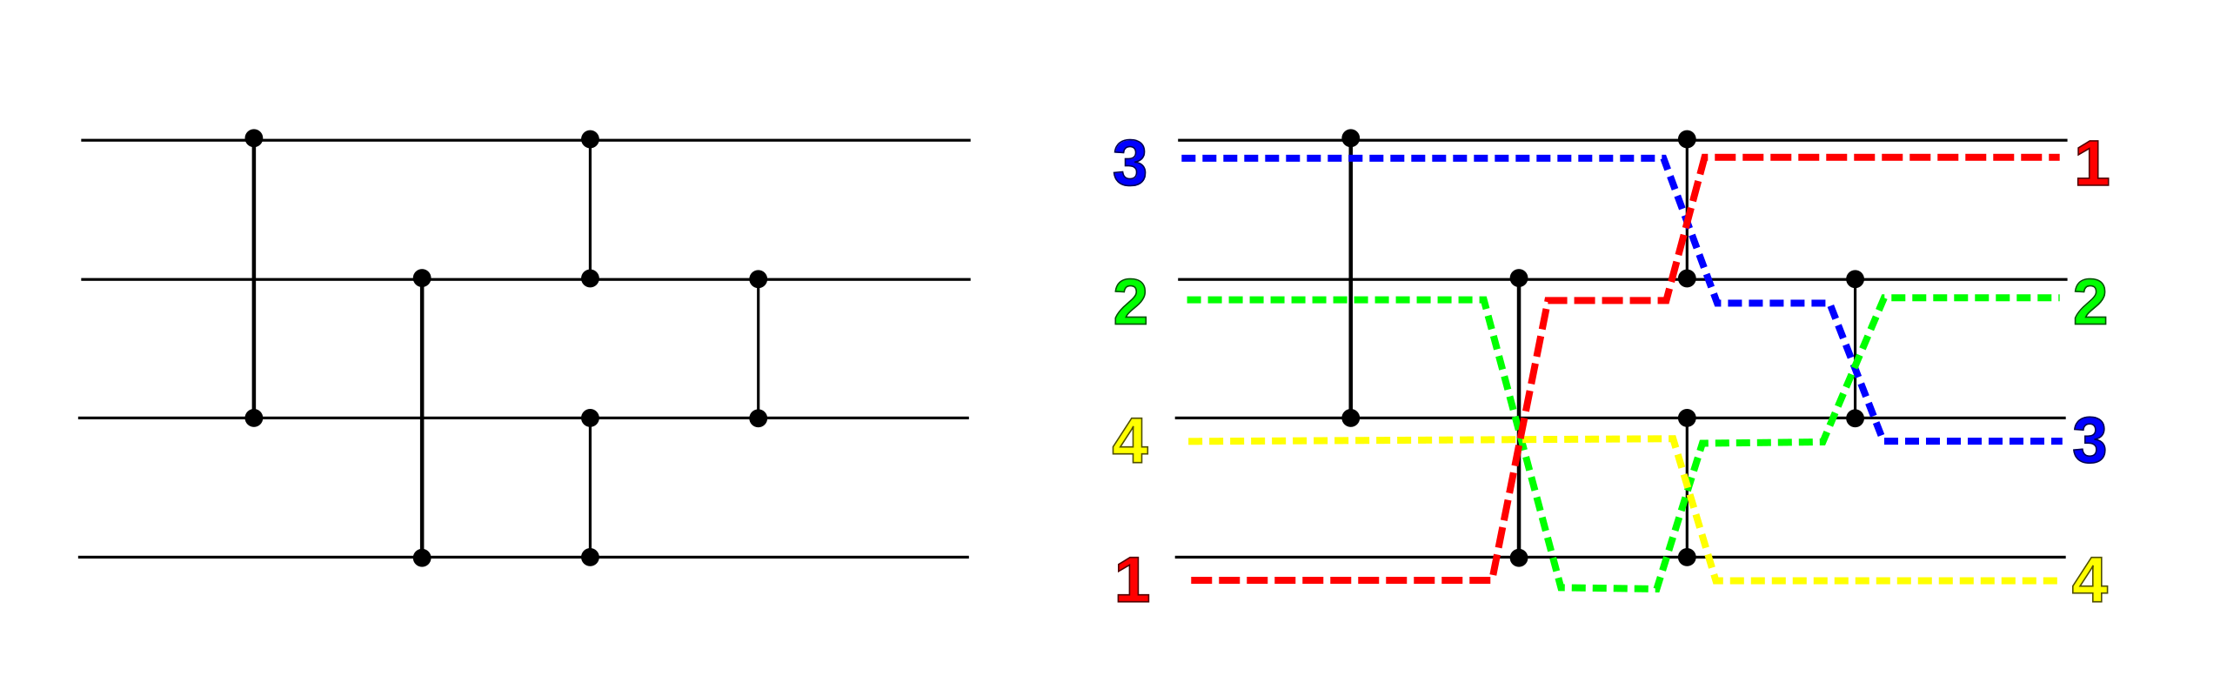
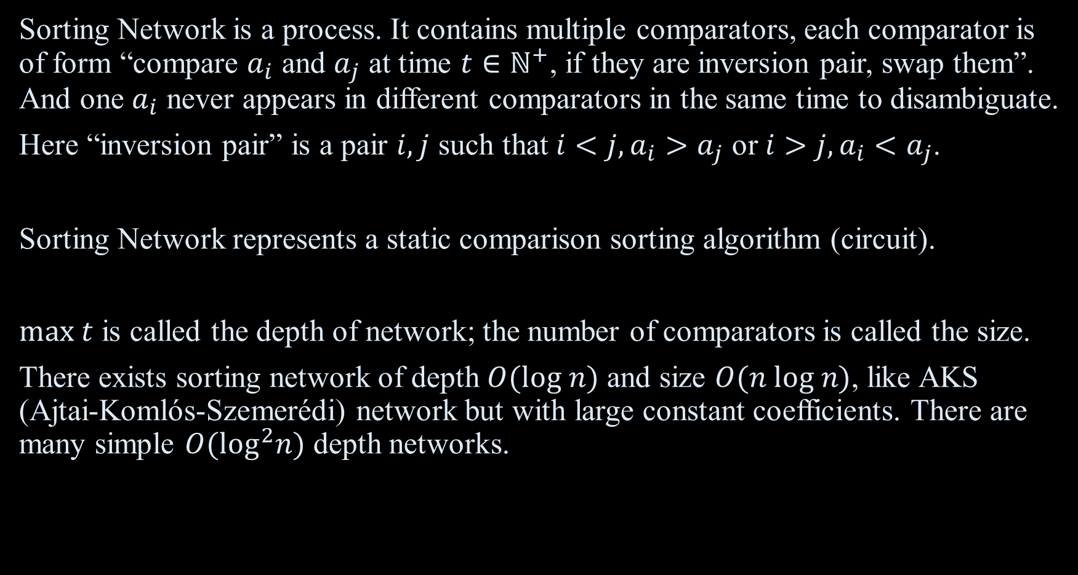
Sorting Network
Sorting Network is a process. It contains multiple comparators, each comparator is of form “compare $a_{i}$ and $a_{j}$ at time $t∈ℕ^{+}$, if they are inversion pair, swap them”. And one $a_{i}$ never appears in different comparators in the same time to disambiguate.
Here “inversion pair” is a pair $i,j$ such that $i<j,a_{i}>a_{j}$ or $i>j,a_{i}<a_{j}$.
Sorting Network represents a static comparison sorting algorithm (circuit).
$max t$ is called the depth of network; the number of comparators is called the size.
There exists sorting network of depth $O(log n)$ and size $O(n log n)$, like AKS (Ajtai-Komlós-Szemerédi) network but with large constant coefficients. There are many simple $O(\log^{2}n)$ depth networks.

Slide 14
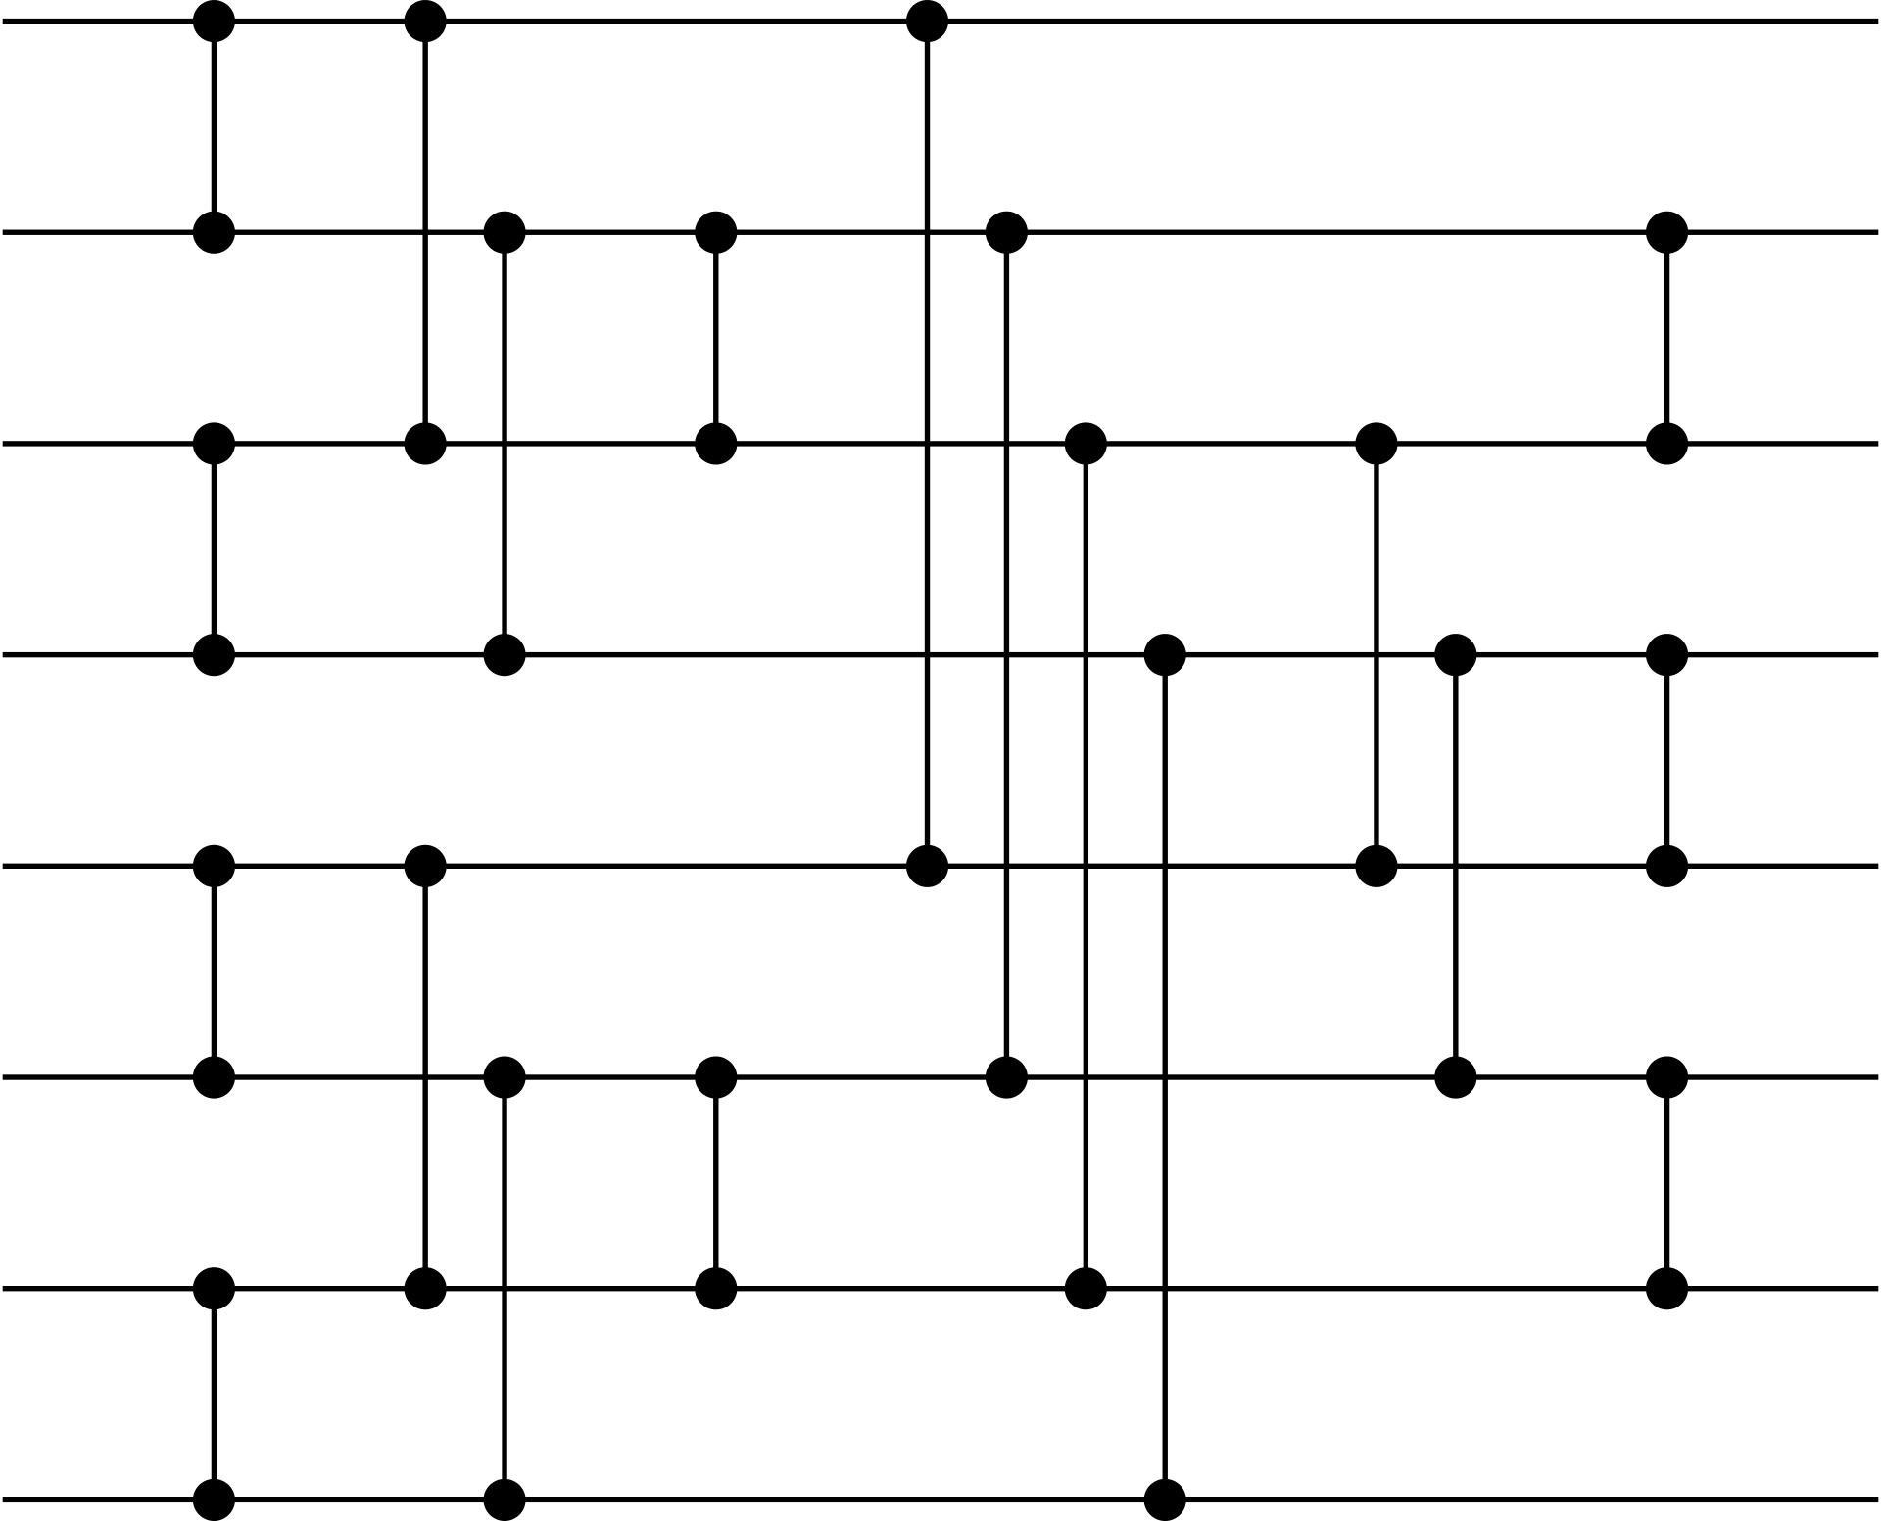

Sorting Network: An Example
Batcher's odd–even merge sort:
Each segment $[2kp,2\left(k+1\right)p)$ is sorted after the outside cycle $p$:
$p=1$ is clearly true. By induction we only need to merge two ordered segments of length $p$.
How to merge?
// C++ style code; 0-based index
for (int p = 1; p < n; p <<= 1)
for (int k = p; k >= 1; k >>= 1)
for (int j = k%p; j+k < n; j += 2*k)
for (int i = 0; i < k; i++)
if ((i+j)/(p*2) == (i+j+k)/(p*2) && i+j+k<n)
comparator(i+j, i+j+k)

Slide 15

Determining Sorting Networks
Co-NP Complete to Determine whether a comparator network is sorting network. (That is, whether it can sort any sequence)
How to determine?
Naive: check all $n!$ permutations.
Idea: replace permutations with condensed coordinates, like $\{0,1\}$.

Slide 16
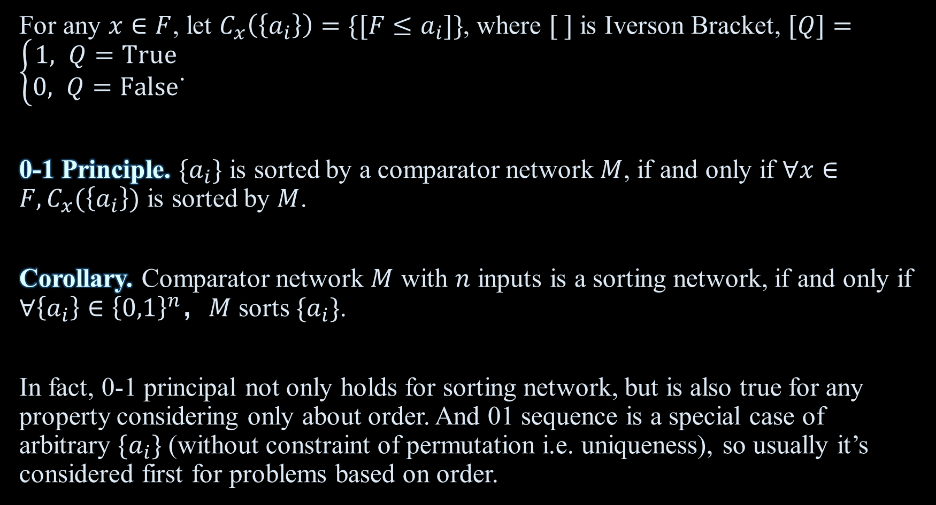
0-1 Principle
For any $x∈F$, let $C_{x}\left(\left\{a_{i}\right\}\right)=\{[F≤a_{i}]\}$, where $[ ]$ is Iverson Bracket, $[Q]=\left\{\begin{aligned}1, Q=True \\ &0, Q=False\end{aligned}\right.$.
0-1 Principle. $\{a_{i}\}$ is sorted by a comparator network $M$, if and only if $∀x∈F,C_{x}(\left\{a_{i}\right\})$ is sorted by $M$.
Corollary. Comparator network $M$ with $n$ inputs is a sorting network, if and only if $∀\left\{a_{i}\right\}∈{\left\{0,1\right\}}^{n}$，$M$ sorts $\{a_{i}\}$.
In fact, 0-1 principal not only holds for sorting network, but is also true for any property considering only about order. And 01 sequence is a special case of arbitrary $\{a_{i}\}$ (without constraint of permutation i.e. uniqueness), so usually it’s considered first for problems based on order.

Slide 17
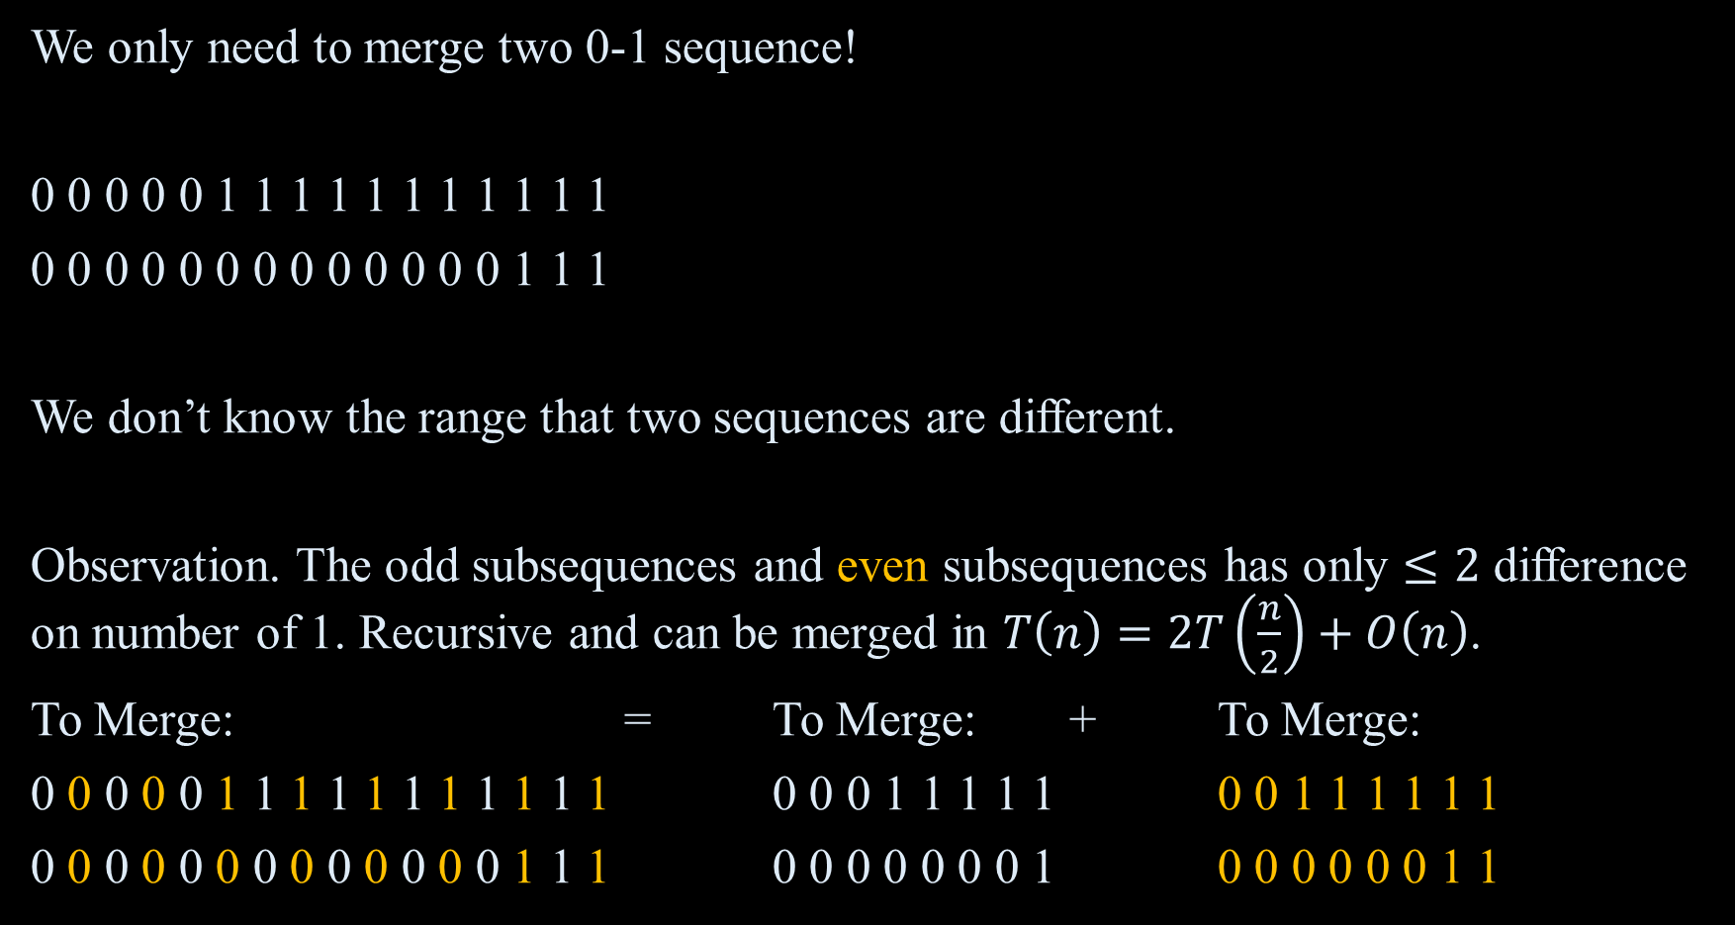
Example. Analysis of Odd-Even Merge Sort
We only need to merge two 0-1 sequence!
0 0 0 0 0 1 1 1 1 1 1 1 1 1 1 1
0 0 0 0 0 0 0 0 0 0 0 0 0 1 1 1
We don’t know the range that two sequences are different.
Observation. The odd subsequences and even subsequences has only $≤2$ difference on number of 1. Recursive and can be merged in $T\left(n\right)=2T\left(\frac{n}{2}\right)+O\left(n\right)$.
To Merge: = To Merge: + To Merge:
0 0 0 0 0 1 1 1 1 1 1 1 1 1 1 1 0 0 0 1 1 1 1 1 0 0 1 1 1 1 1 1
0 0 0 0 0 0 0 0 0 0 0 0 0 1 1 1 0 0 0 0 0 0 0 1 0 0 0 0 0 0 1 1

Slide 18

Example. USACO 2018 Out of Sorts (S)
Input $A$, $\left|A\right|≤{10}^{5}$, Output the final result of moo for the following code:
sorted = false
while (not sorted):
sorted = true
moo
for i = 0 to N-2:
if A[i+1] < A[i]:
swap A[i], A[i+1]
sorted = false

Slide 19
Example. USACO 2018 Out of Sorts (G)
Input $A$, $\left|A\right|≤{10}^{5}$, Output the final result of moo for the following code:
sorted = false
while (not sorted):
sorted = true
moo
for i = 0 to N-2:
if A[i+1] < A[i]:
swap A[i], A[i+1]
for i = N-2 downto 0:
if A[i+1] < A[i]:
swap A[i], A[i+1]
for i = 0 to N-2:
if A[i+1] < A[i]:
sorted = false

Slide 20

Example. USACO 2018 Out of Sorts (P)
Input $A$, $\left|A\right|≤{10}^{5}$, Output the final result of work_counter for the following code:
bubble_sort_pass (A) {
for i = 0 to length(A)-2
if A[i] > A[i+1], swap A[i] and A[i+1]
}
quickish_sort (A) {
if length(A) = 1, return
do { // Main loop
work_counter = work_counter + length(A)
bubble_sort_pass(A)
} while (no partition points exist in A)
divide A at all partition points; recursively quickish_sort each piece
}

Slide 21

Analysis View
Use 0-1 principle and matrix/plane of $\{(i,p_{i})\}$.

Slide 22

The Alternative Representations
Alternative representations of a permutation $\left\{p_{i}\right\}$:
$\{a_{i}=\sum_{j<i}{[p_{j}^{−1}}>p_{i}^{−1}]\}$
$\{p_{i}\}$ is ordered if and only if:
$∀i, p_{1},p_{2},…,p_{i}≤i$

Slide 23
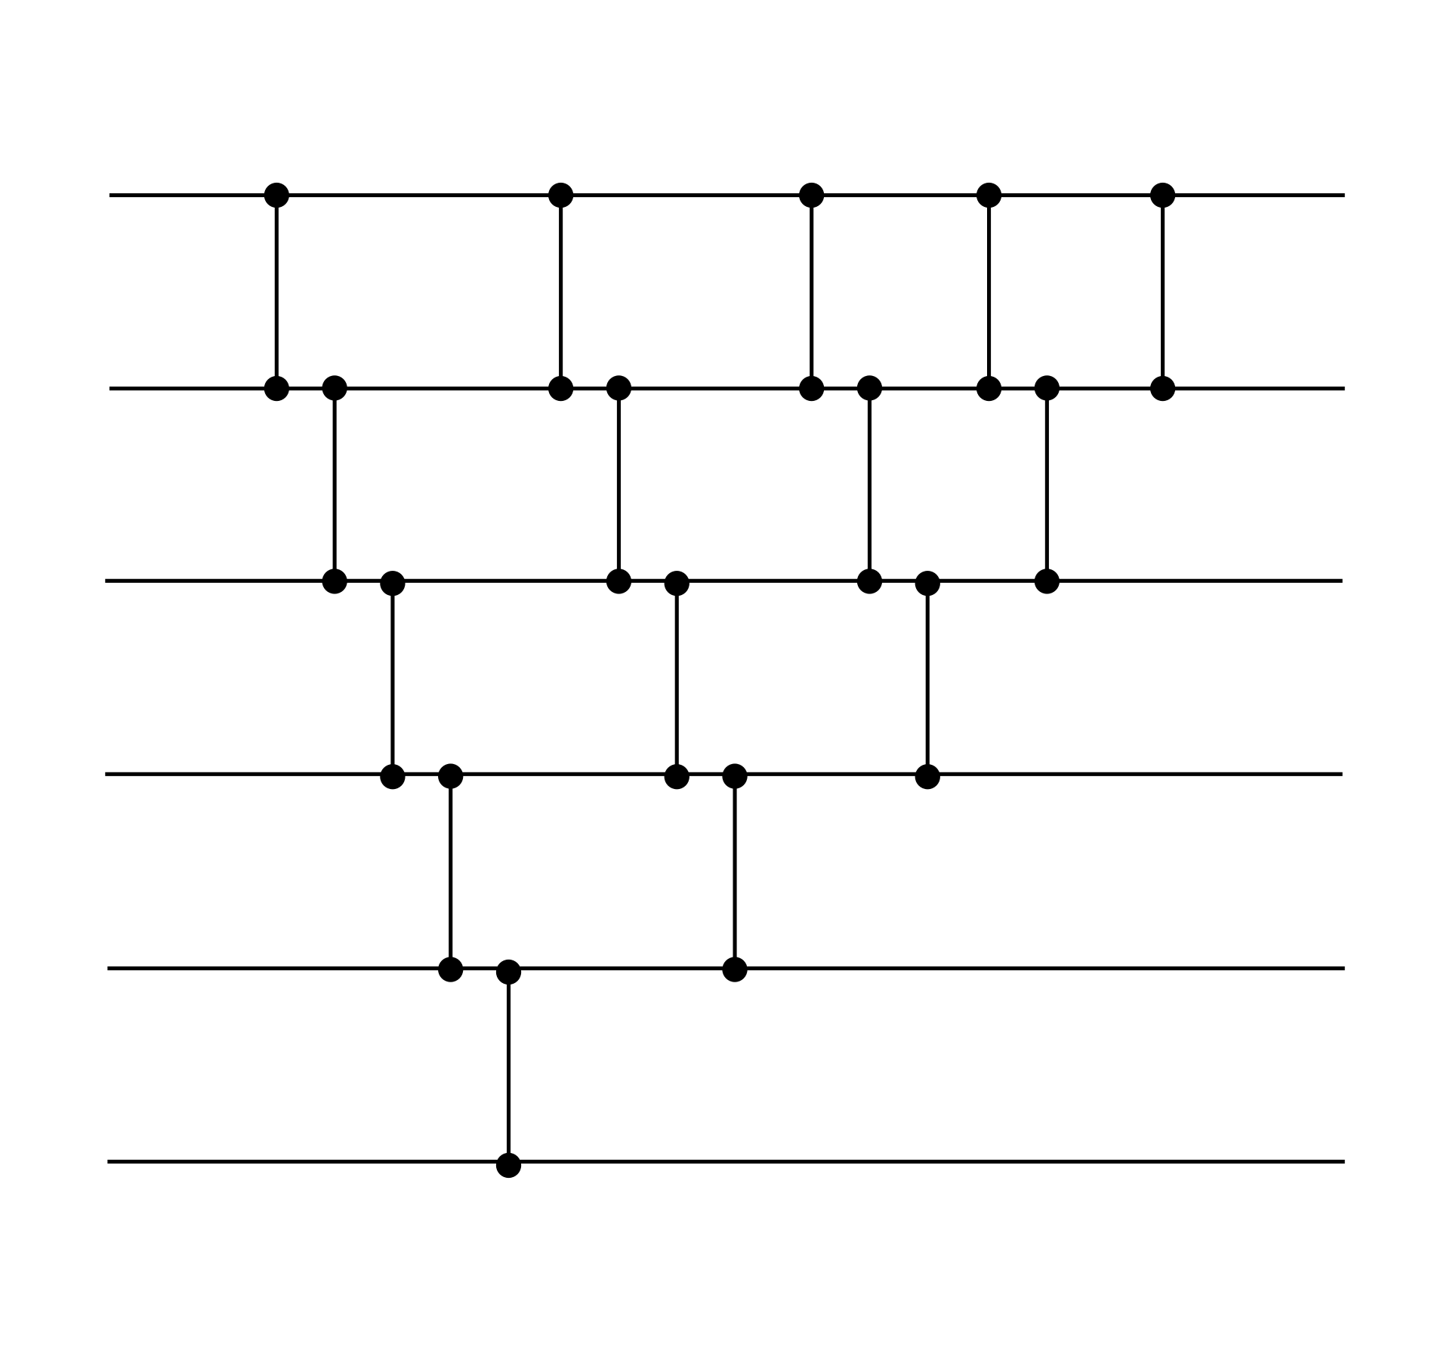
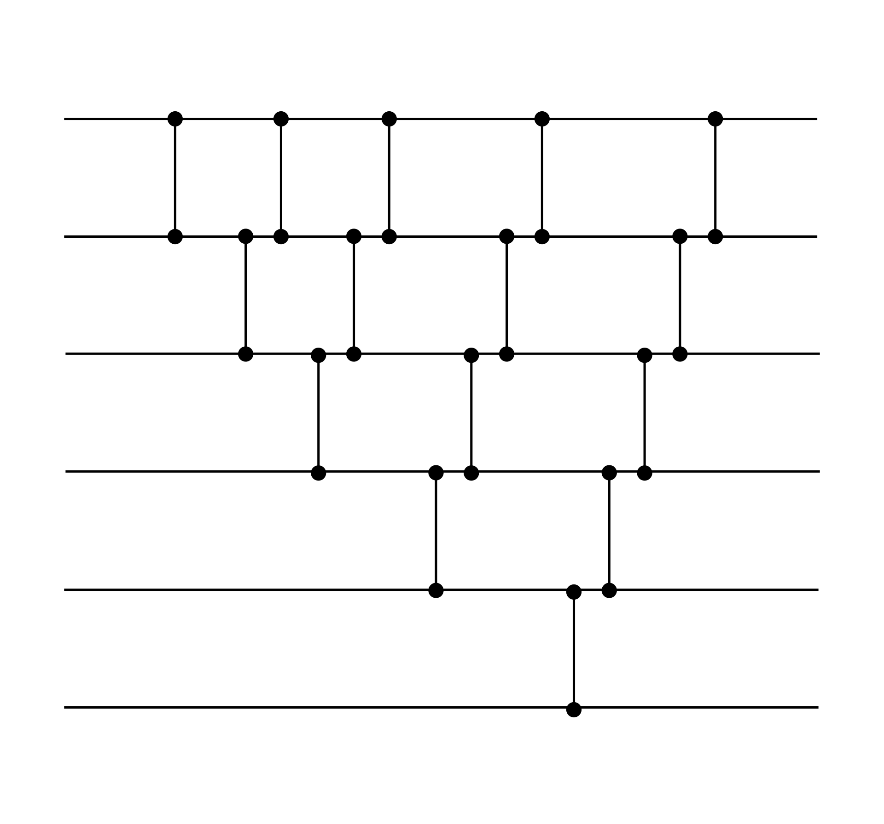
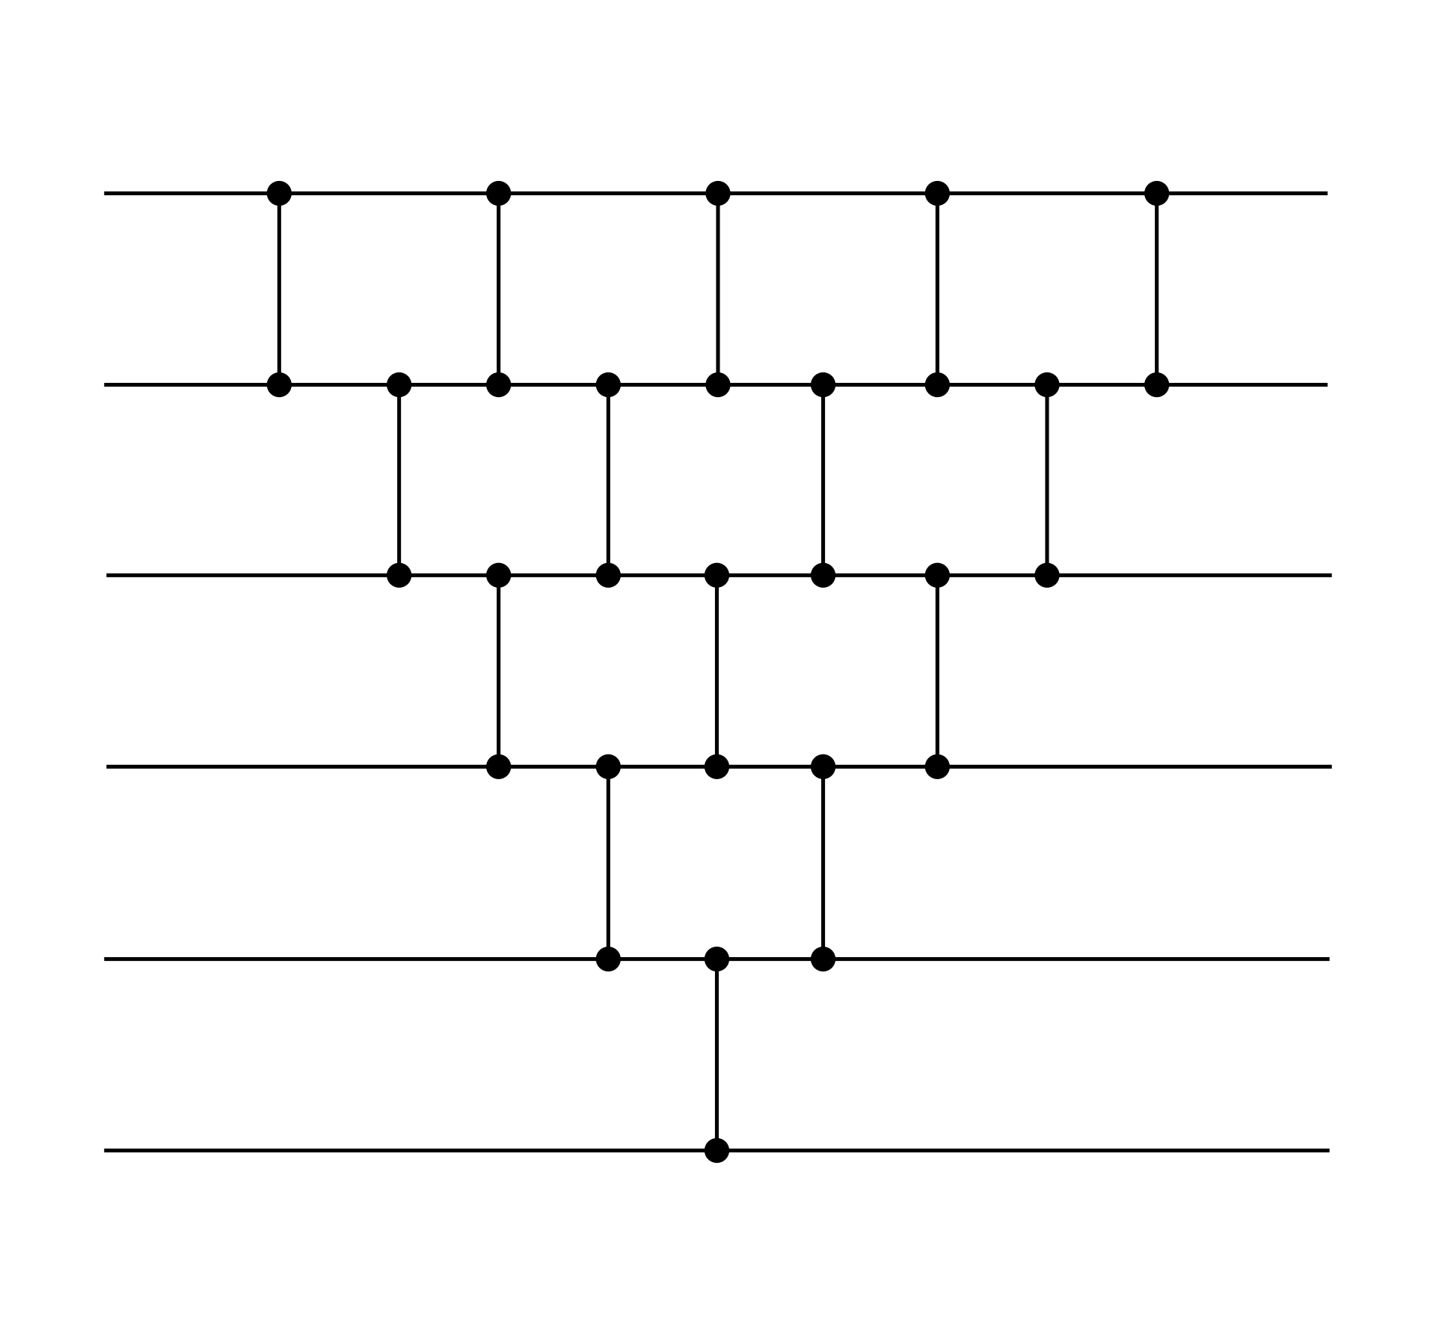
Equivalence/Duality of (Parallel) Bubble and Selection Sort
Bubble Selection Parallel

Slide 24
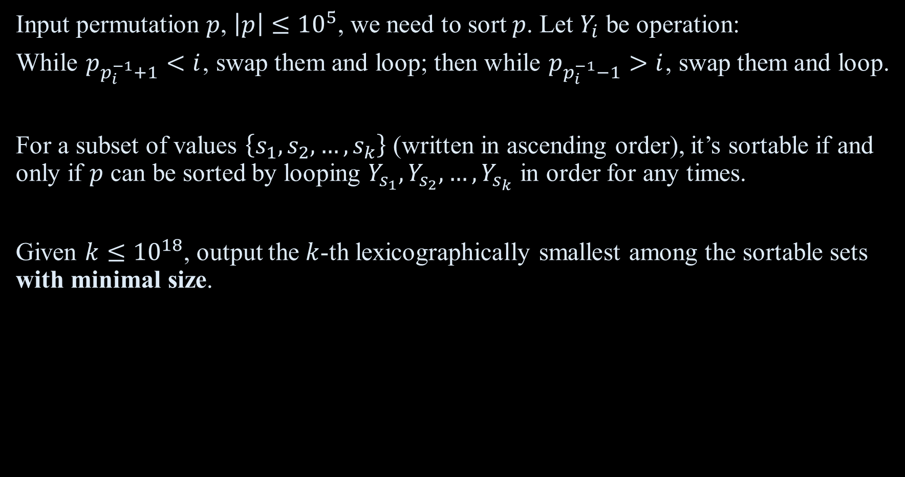
Example. USACO 2018 Sort It Out
Input permutation $p$, $\left|p\right|≤{10}^{5}$, we need to sort $p$. Let $Y_{i}$ be operation:
While $p_{p_{i}^{−1}+1}<i$, swap them and loop; then while $p_{p_{i}^{−1}−1}>i$, swap them and loop.
For a subset of values $\left\{s_{1},s_{2},…,s_{k}\right\}$ (written in ascending order), it’s sortable if and only if $p$ can be sorted by looping $Y_{s_{1}},Y_{s_{2}},…,Y_{s_{k}}$ in order for any times.
Given $k≤{10}^{18}$, output the $k$-th lexicographically smallest among the sortable sets with minimal size.

Slide 25

Codeforces 1552G A Serious Referee
Input a sorting process, it inputs a sequence of length $n≤40$, and applies $k≤10$ operations, each operation $i$ is of form “sorting a subsequence of indices $j_{i,1},j_{i,2},…,j_{i,q_{i}}$ and keeping the elements currently on other indices”.
Output whether the process sorts all possible sequences of length $n$.

Slide 26
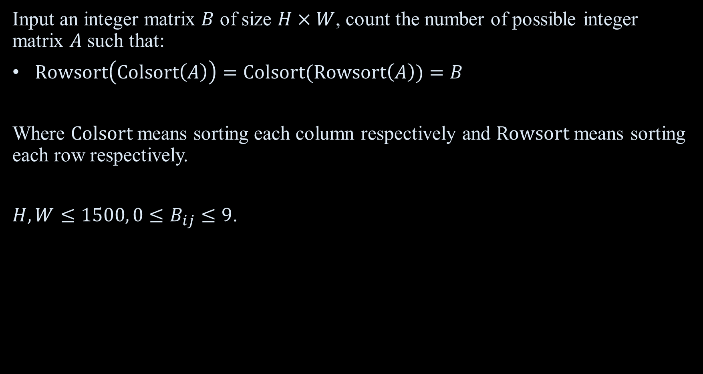
AGC 057E RowCol/ColRow Sort
Input an integer matrix $B$ of size $H×W$, count the number of possible integer matrix $A$ such that:
$Rowsort\left(Colsort\left(A\right)\right)=Colsort(Rowsort\left(A\right))=B$
Where $Colsort$ means sorting each column respectively and $Rowsort$ means sorting each row respectively.
$H,W≤1500, 0≤B_{ij}≤9$.

Slide 27

Codeforces 1427G One Billion Shades of Grey
Input a square matrix of size $n×n (3≤n≤200)$, some elements are broken, some elements has a fixed weight, and others are to be assigned a weight. Weight must be an integer in $\left[{1, 10}^{9}\right]$. Every adjacent pair of unbroken elements has a cost of the absolute value of the difference between their weights. You need to assign the weights to minimize the sum of all costs.
Output the minimum cost.

Slide 28
Q&A
GL&HF
CommonAnts (Liu Cheng-ao)
2022.7

